Slide 1
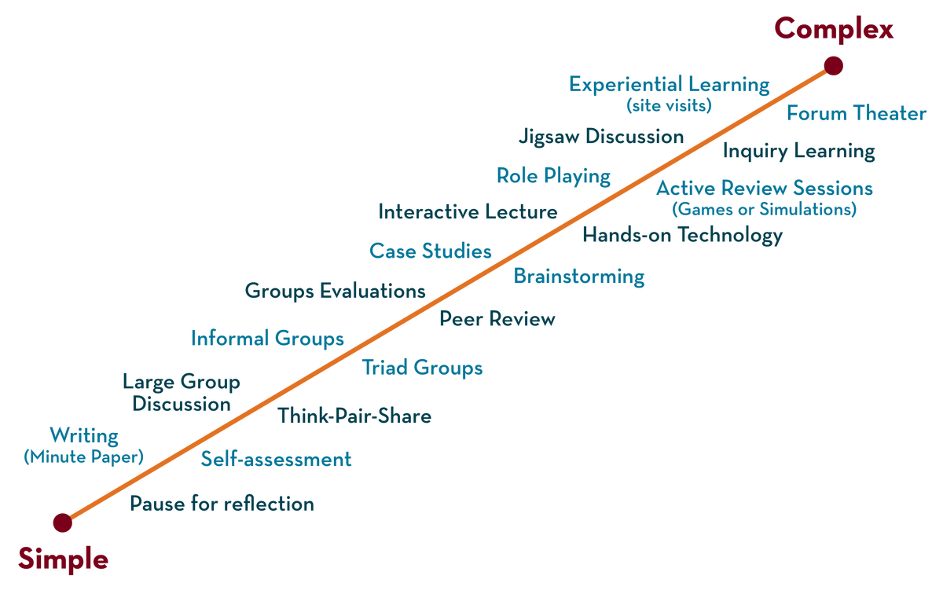
NETWORKS, PROTOCOLS & SECURITY (NPS) 22EC2210R Topic: NETWORK HARDWARE NETWORKSOFTWARE
Session - 02

Slide 2




AIM OF THE SESSION
To familiarize students with the basic concept of computer networks and its necessity
INSTRUCTIONAL OBJECTIVES
This Session is designed to:
Introduction to NETWORK HARDWARE
Describe the Features Of Computer network
Introduction to NETWORK TOPOLOGIES
LEARNING OUTCOMES
At the end of this session, you should be able to:
Describe the Introduction to NETWORK HARDWARE
Describe the Introduction to NETWORK TOPOLOGIES

Slide 3
Syllabus
Introduction to networks: Introduction to Computer networks Use of Computer Networks, Network Topologies, types of networks, Reference models: OSI and TCP/IP,

Slide 4
COMPUTER NETWORK HARDWARE
Network Cables
Distributors
Routers
Socket.
Port
Network Card

Slide 5
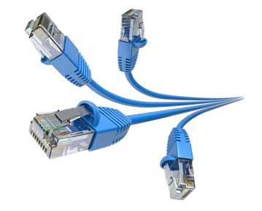
Network Cables
Network cables are used to connect computers. RJ-45 Category 5 cable is the most often used cable.

Slide 6
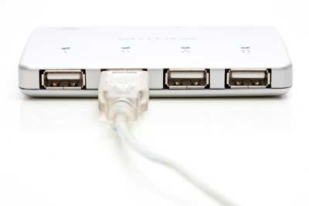
Distributors
A computer may be connected to another using a serial port; however, if we need to connect numerous computers to create a network, this serial connection will fail.

Slide 7
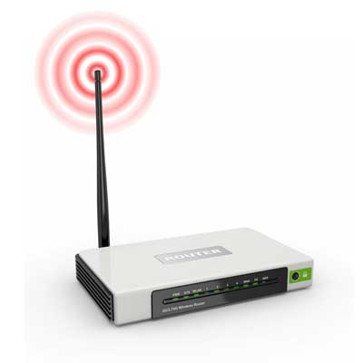
Router
A router is an equipment that serves as the hub for computers and other network-connected devices. It has openings called ports in it. Computers and other devices are connected to a router through network cables. Nowadays, routers are available in wireless modes, allowing computers to be connected without needing a physical connection.

Slide 8
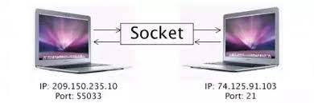
socket
A socket is one endpoint of a two way communication link between two programs running on the network. The socket mechanism provides a means of inter-process communication (IPC) by establishing named contact points between which the communication take place.

Slide 9
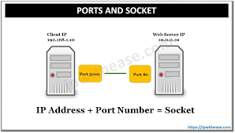
port
In computer networking, a port or port number is a number assigned to uniquely identify a connection endpoint and to direct data to a specific service. At the software level, within an operating system, a port is a logical construct that identifies a specific process or a type of network service. A port at the software level is identified for each transport protocol and address combination by the port number assigned to it. The most common transport protocols that use port numbers are the Transmission Control Protocol (TCP) and the User Datagram Protocol (UDP); those port numbers are 16-bit unsigned numbers.

Slide 10
Repeaters, Hubs, and Switches
Repeaters, hubs and switches connect network devices together so that they can function as a single segment.
A repeater receives a signal and regenerates it before re-transmitting so that it can travel longer distances.
A hub is a multiport repeater having several input/output ports, so that input at any port is available at every other port.
A switch receives data from a port, uses packet switching to resolve the destination device and then forwards the data to the particular destination, rather than broadcasting it as a hub.

Slide 11
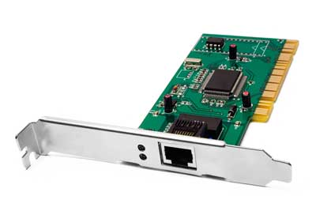
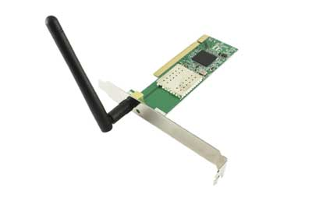
Network Card
A network card is a component of a computer connected to a network computer. It is sometimes referred to as a network adapter or Network Interface Card (NIC). Most brand-name computers come with a network card pre-installed. Internal and external network cards are the two types of network cards.

Slide 12
TYPES OF NETWORKS
LAN(Local Area Network)
PAN(Personal Area Network)
MAN(Metropolitan Area Network)
WAN(Wide Area Network)

Slide 13
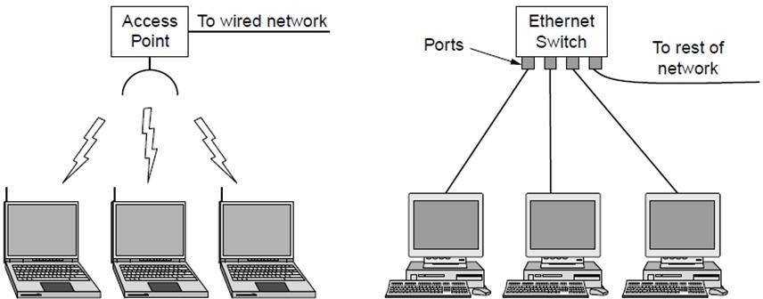
Local Area Networks
Wireless and wired LANs. (a) 802.11. (b) Switched Ethernet.

Slide 14
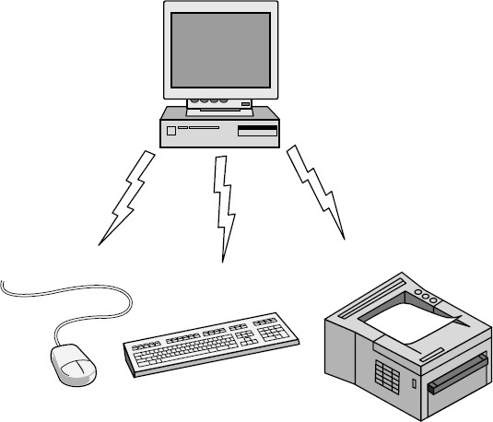
Personal Area Network
Bluetooth PAN configuration

Slide 15
Local Area Networks
Characteristics
small size
transmission technology
single cable (single channel)
10Mbps ~ 10Gb/s
10Gb/s : 10,000,000.000 bps

Slide 16
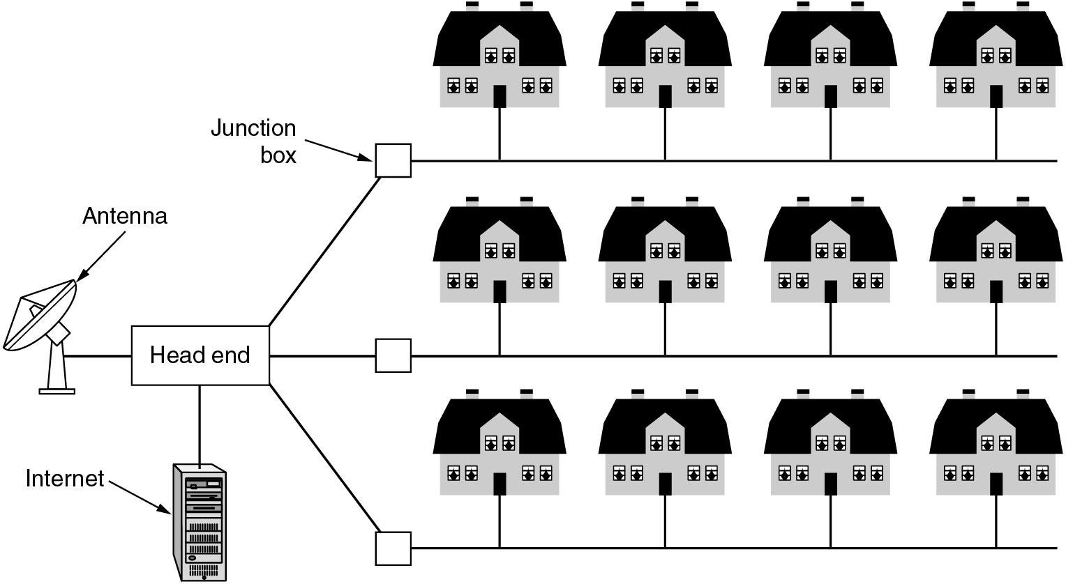
Metropolitan Area Networks
A metropolitan area network based on cable TV.
24

Slide 17
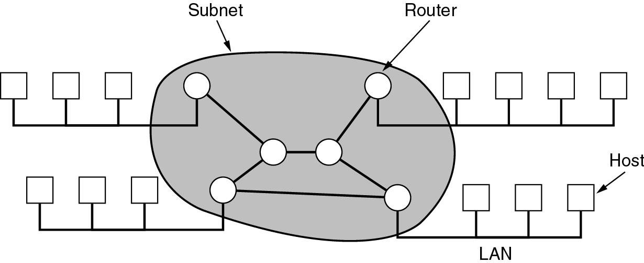
Wide Area Networks (WANs)
·WANs are point-to-point networks
·WANs consist of two distinct components:
transmission lines (copper, fiber, microwave) and switches (electronics, optics)
Store-and-forward or packet-switched subnet
Relation between hosts on LANs and the subnet.
25

Slide 18
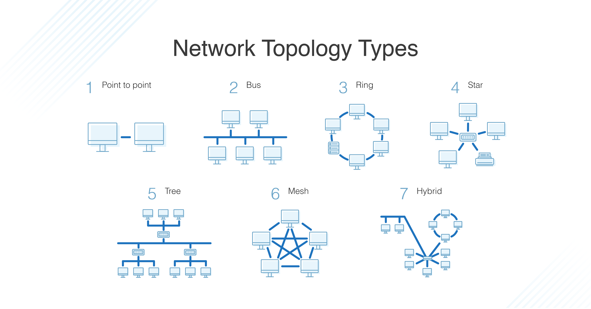
Network Topology
2
9

Slide 19
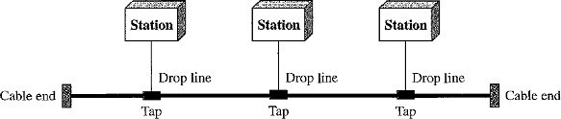
Bus Topology
A bus topology is multipoint connection, one long cable acts as a backbone to link all the devices in a network. Here the cable is called the bus.
Bus topology was the one of the first topologies used in the design of early local area networks.
Nodes are connected to the bus cable by drop lines and taps.
A drop line is a connection running between the device and the main cable.
A tap is a connector that splices into (attached to) the main cable.

Slide 20
Advantages: 1. Installation is easy. Bus Backbone cable can be laid along the most efficient path and then connected to the nodes by drop lines of various lengths. 2. A bus uses less cabling than mesh or star topologies. Disadvantages: 1. All the devices are connected to bus backbone cable, so that if the backbone cable fails the entire system fails. 2. Difficult Reconnection and Fault Isolation. It is difficult to add new devices. 3. There is a limit on the number of taps a bus can support and on the distance between those taps. 4. More heat is generated if the number of taps are more. Heat degrades the quality of signal.

Slide 21
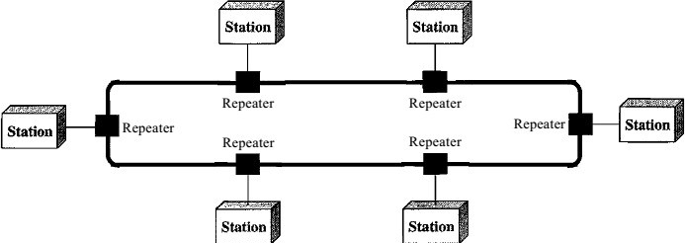
Ring Topology
In a ring topology, each device has a dedicated point-to-point connection with only the two devices on either side of it. A signal is passed along the ring in one direction from device to device, until it reaches its destination. Each device in the ring incorporates a repeater. When a device receives a signal intended for another device, its repeater regenerates the bits and passes them along.

Slide 22
CONTD
Advantages: 1. A ring is relatively easy to install and reconfigure. Each device is linked to only its immediate neighbors (either physically or logically). 2. To add or delete a device requires changing only two connections. 3. The only constraints are media and traffic considerations (maximum ring length and number of devices). Disadvantage: 1. Unidirectional traffic can be a disadvantage. 2. In a simple ring, a break in the ring (such as a disabled station) can disable the entire network.

Slide 23
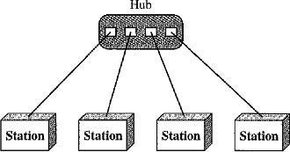
Star Topology
In a star topology, each device has a dedicated point-to-point link only to a central controller called a Hub or Switch. The devices are not directly linked to one another.
A star topology does not allow direct traffic between devices. The controller acts as an exchange: If one device wants to send data to another, it sends the data to the controller, and the controller transfers the data to the other connected device.

Slide 24
Advantages: 1. A star topology is less expensive than a mesh topology. In a star, each device needs only one link and one I/O port to connect it to any number of others. This factor also makes it easy to install and reconfigure 2. Less cabling is required than mesh topology. 3. Star topology is robust, If one link fails, only that link is affected. All other links remain active. Disadvantages: 1. If hub fails entire processing will be stopped working. Uses: 1. It is used in High-speed LAN’s often use a star topology with a central hub.

Slide 25
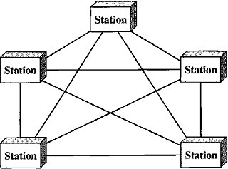
Mesh Topology
In a mesh topology, every device has a Dedicated Point-to-Point link to every other device. (i.e.) for each node there is a link to all other nodes.
The term Dedicated means that the link carries traffic only between the two devices it connects.

Slide 26
Hybrid Topology
It is a combination of two or more topologies for example star topology with each branch connecting several stations in a bus topology

Slide 27
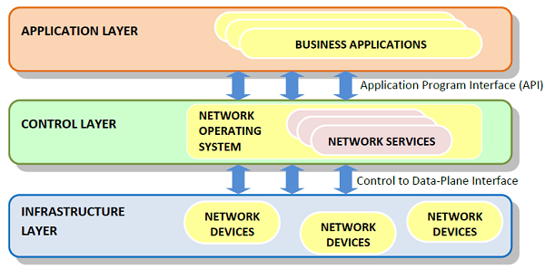
Network Software
Network software encompasses a broad range of software used for design, implementation, and operation and monitoring of computer networks. Traditional networks were hardware based with software embedded. With the advent of Software – Defined Networking (SDN), software is separated from the hardware thus making it more adaptable to the ever-changing nature of the computer network.

Slide 28
SDN Framework
The Software Defined Networking framework has three layers as depicted in the following diagram −
APPLICATION LAYER − SDN applications reside in the Application Layer. The applications convey their needs for resources and services to the control layer through APIs.
CONTROL LAYER − The Network Control Software, bundled into the Network Operating System, lies in this layer. It provides an abstract view of the underlying network infrastructure. It receives the requirements of the SDN applications and relays them to the network components.
INFRASTRUCTURE LAYER − Also called the Data Plane Layer, this layer contains the actual network components. The network devices reside in this layer that shows their network capabilities through the Control to data-Plane Interface.

Slide 29
SELF-ASSESSMENT QUESTIONS
COMPUTER TOPOLOGIES ARE ………….. TYEPS
6
7
5
3
Ethernet (IEEE 802.3): ……………………..Mbps (10Gb/s)

Slide 30
TERMINAL QUESTIONS
Describe the NETWORK HARDWARE
List out the FEATURES OF COMPUTER NETWORK
Describe the Purpose of. the TOPOLOGIES

Slide 31
REFERENCES FOR FURTHER LEARNING OF THE SESSION
Reference Books:
Simon Haykin and Michael Moher, “An Introduction to Analog and Digital Communications”, 2nd Ed., Wiley, (2007).
Wayne Tomasi,”Advanced Electronic Communication Systems”, 6th Ed., Pearson Education.
B P Lathi and W.Ding, “Modern Digital and Digital and Analog Communication,” ”, 4th Ed., Wiley, (2007).
Sites and Web links:
1. https://archive.nptel.ac.in/courses/108/106/108106163/
2. https://onlinecourses.nptel.ac.in/noc22_ee32/preview
3. https://onlinecourses.nptel.ac.in/noc23_ee05/preview

Slide 32
THANK YOU
Team –NETWORK PROTOCOLS & SECURITY (NPS)

